Slide 1
Tree Application:
Expression Tree
Mohammad Shahid Qureshi

Slide 2
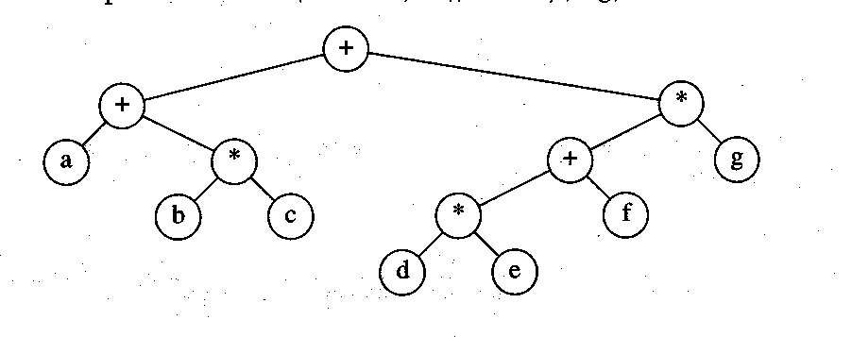
Expression Trees
Expression tree for:
(a+b*c) +((d*e+f)*g)

Slide 3
Expression Tree
A Binary Tree built with operands and operators.
Also known as a parse tree.
Used in compilers.

Slide 4
Example: Expression Tree
+
/
/
1
3
*
4
6
7
1/3 + 6*7 / 4

Slide 5
Writing Arithmetic expressions
Usually we write arithmetic expressions in the form as shown below
  (2 + 3) * 7 infix notation
Can we have a representation, in which we are not required to use the parenthesis,
  * + 2 3 7 prefix notation
  Or
  2 3 + 7 * postfix notation

Slide 6
Notation
Preorder
  Prefix Notation
Inorder
  Infix Notation
Postorder
  Postfix Notation

Slide 7
Trees Traversal
Inorder
  (Left) node (Right)
Preorder
  node (Left) (Right)
Postorder
  (Left) (Right) node
Root
Left
Right

Slide 8
Example: Infix
+
/
/
1
3
*
4
6
7
1
/
3
+
6
*
7
/
4

Slide 9
Example: Postfix
+
+
/
/
/
/
1
1
3
*
3
*
4
4
6
6
7
7
1
3
/
6
7
*
4
/
+

Slide 10
Example: Prefix
+
/
/
1
3
*
4
6
7
+
/
1
3
/
*
6
7
4

Slide 11
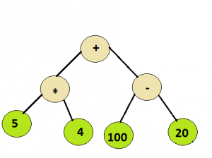
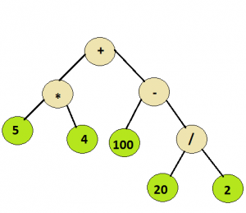
Evaluating Expression Tree
100
110

Slide 12
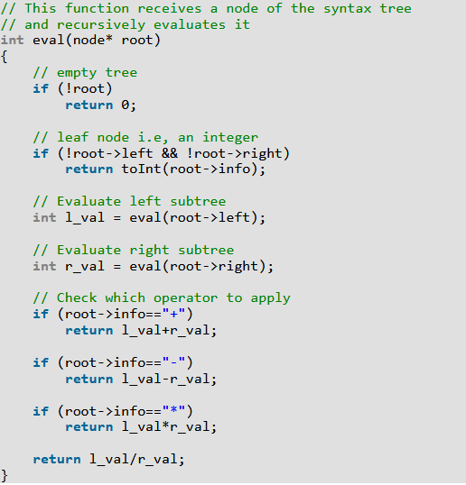
Expression tree evaluation

Slide 14
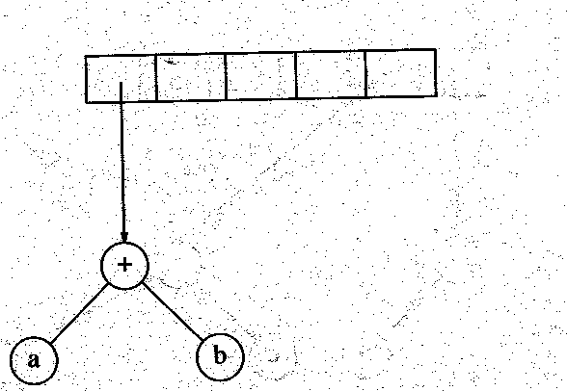
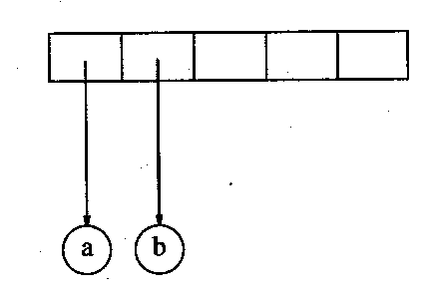
Expression Trees
Algorithm to convert postfix expression into expression tree using Stack
e.g. input: ab+cde+**

Slide 15
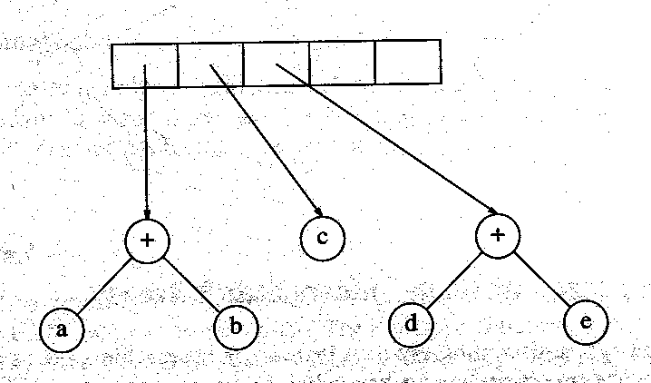
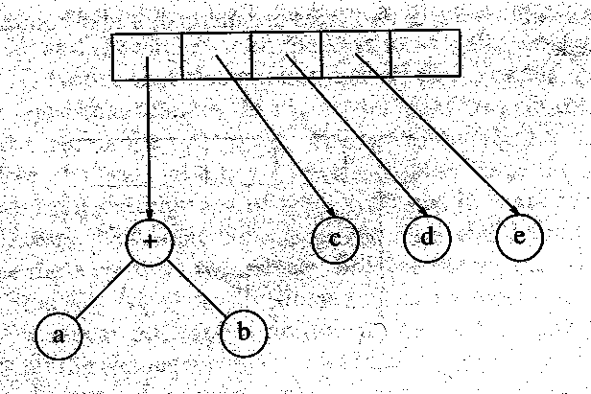
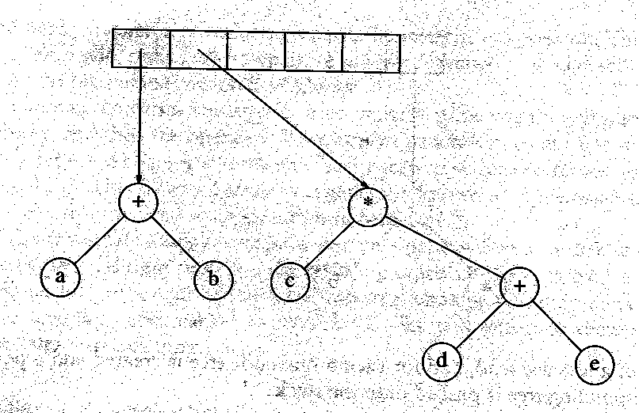
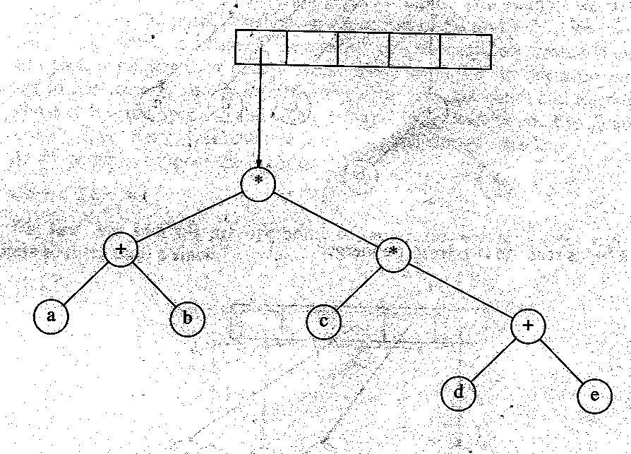
Expression Trees

Slide 16
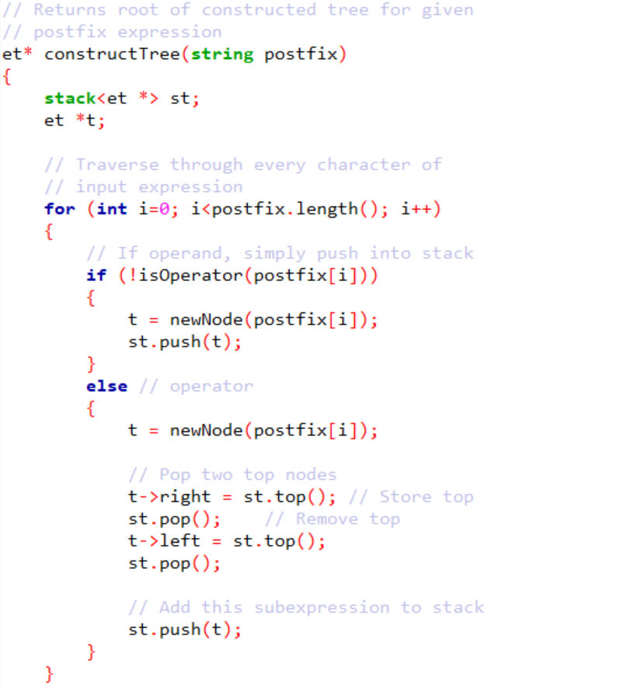
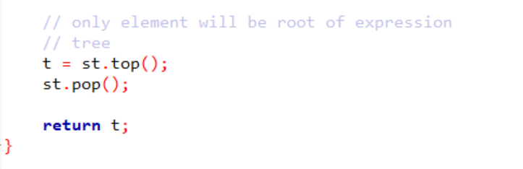

Slide 17

Expression Tree class

